Slide 1
City of Vancouver Navigation Toolbox Development based on GIS
Chao Zhang 200383834

Slide 2

1
Introduction
CONTENTS
2
Background
3
Study Area
4
Description of Datasets
5
Methodology
6
Results and Discussion
7
Summary and Future Work

Slide 3
Introduction
In this project, a navigation toolbox has been created containing four functions in city of Vancouver based on geographic information system(GIS). Users can use this toolbox to find nearest or specified school, library or park from home among Vancouver, get a shortest route between two properties and obtain a shortest path between two given different places.
The toolbox can show users detailed information containing street names, street lengths and positions of intersections, it also can highlight the shortest route on the map.
The motivation of undertaking the research is that using Map APP makes me interesting in GIS.
GIS provides XY coordinates and attributes of every object on the map, relationships among different objects can be found and spatial positions with geographic references are reliable to analyze to create new toolboxs.
1

Slide 4
Background
In previous work, UNA toolbox from MIT City Form Lab is used to solve the shortest route problem and it can get the shortest path easily just by input start and end data.
A new idea came to my mind is to create a navigation toolbox by myself which can calculate the shortest path among the whole Vancouver city network based on Dijkstra's algorithm.
For similarities, Dijkstra's algorithm provides a mathematical solution for finding a shortest path among a weighted graph and the project purpose is also to yield a shortest route among the city network. However, Dijkstra's algorithm can not be used directly among city network and there is a model need to be created for application.
2

Slide 5
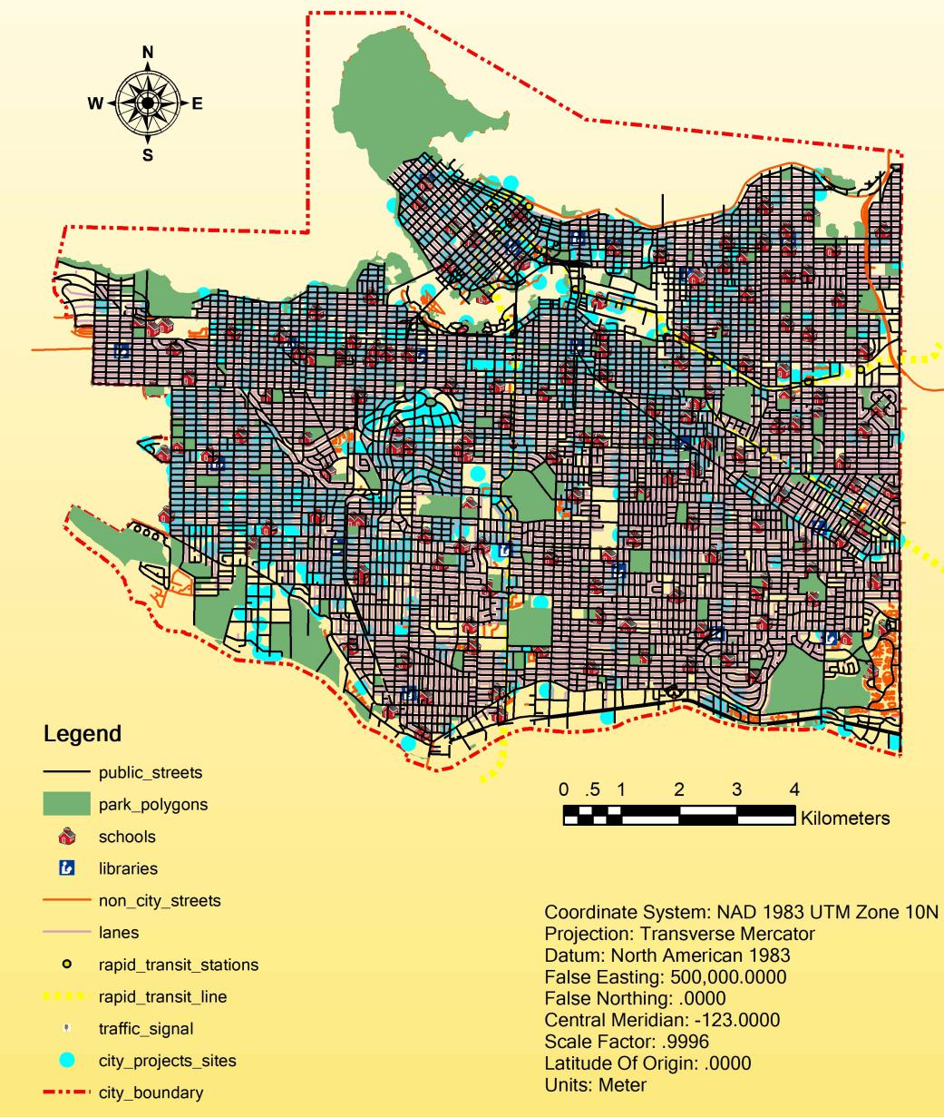
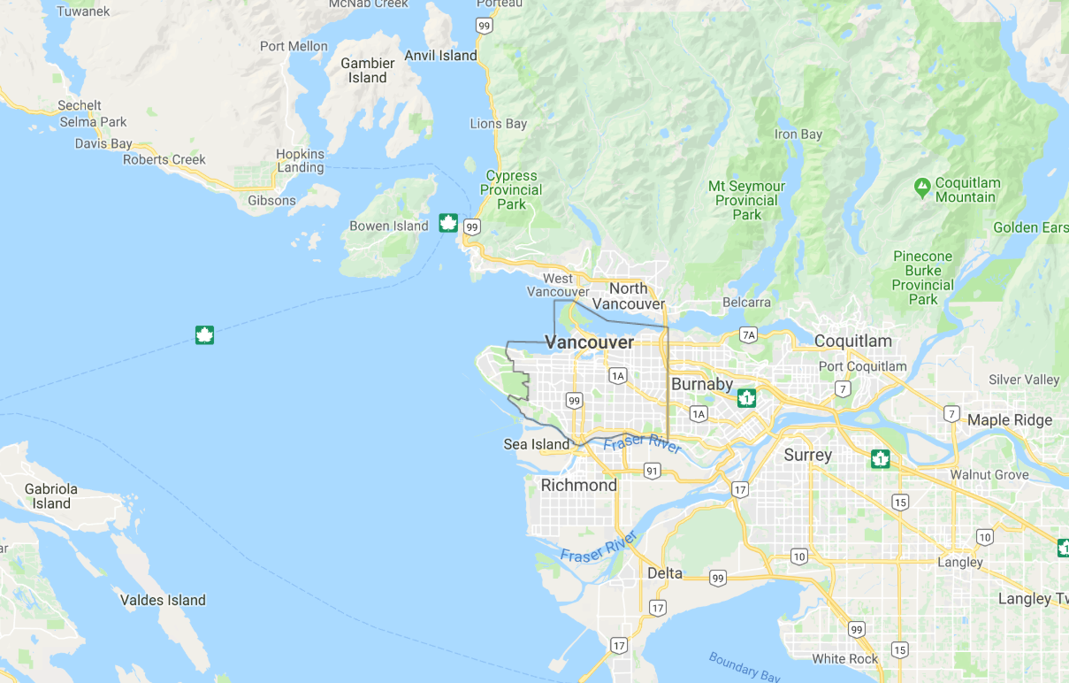

Study Area Description
There are 17013 public streets, 6092 street intersections, 100851 property addresses, 264 parks, 194 schools and 21 libraries.
3

Slide 6
Listing of Input Data
Listing of Attributes for Spatial Analysis
Name of data | Type of data
property addresses | shape file
public streets | shape file
street intersections | shape file
park polygons | shape file
schools | shape file
libraries | shape file
non city streets | shape file
lanes | shape file
rapid transit stations | shape file
rapid transit line | shape file
traffic_signal | shape file
city projects sites | shape file
city boundary | shape file
Name of data | Name of attributes used in analysis
property addresses | FID, Shape*,
public streets | FID, Shape*, Shape_Leng, HBLOCK
street intersections | FID, Shape*, XSTREET
park polygons | FID, Shape*, PARK_NAME
schools | FID, Shape*, NAME
libraries | FID, Shape*, NAME
source: https://data.vancouver.ca/datacatalogue
4

Slide 7
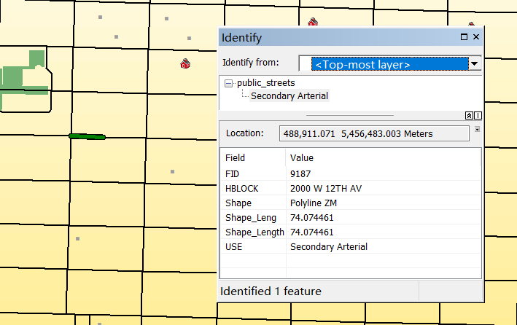
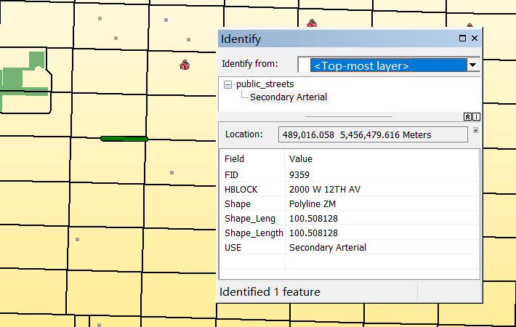
Data Preprocessing
public_street
5

Slide 8
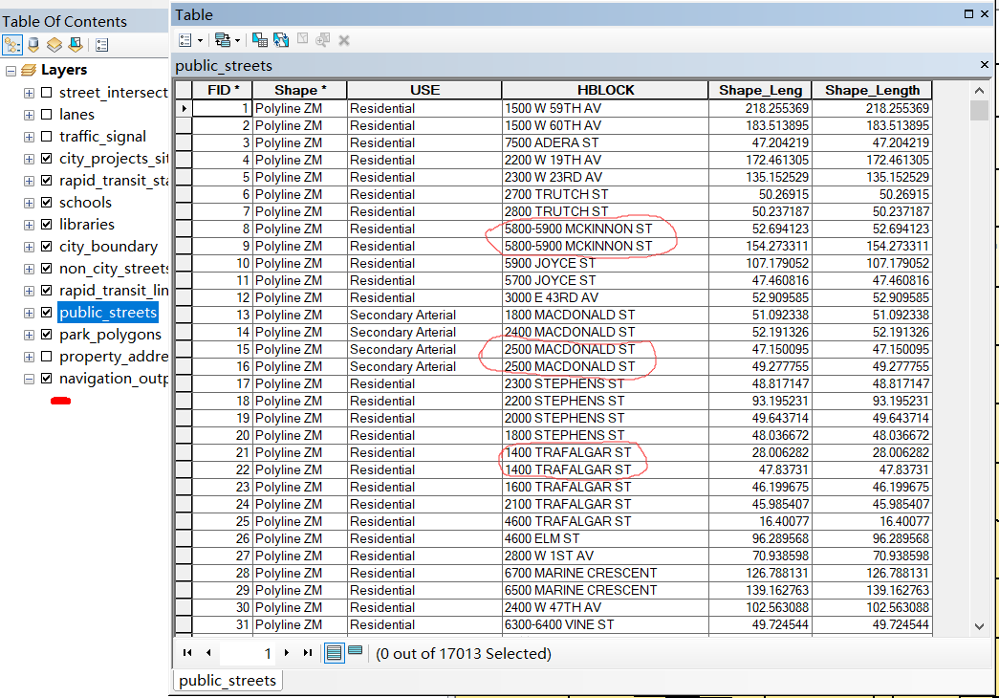
Data Preprocessing
6

Slide 9
General steps of programming
Step 1: Store street intersections
Step 2: Collect necessary spatial data from input
Step 3: Select region which should be analyzed from the map
Step 4: Create graph
Step 5: Use Dijsktra algorithm to output the shortest route
Step 6: Print navigation output and highlight the route
7

Slide 10
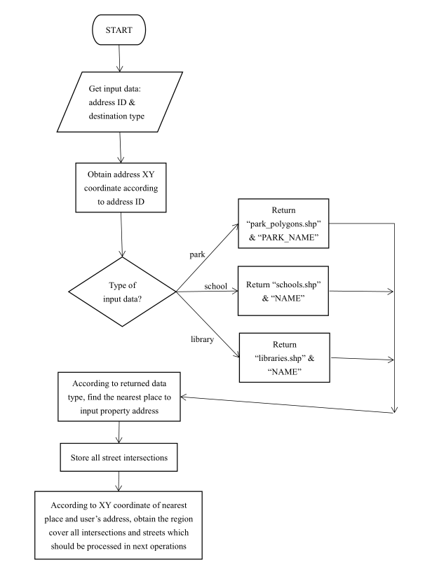
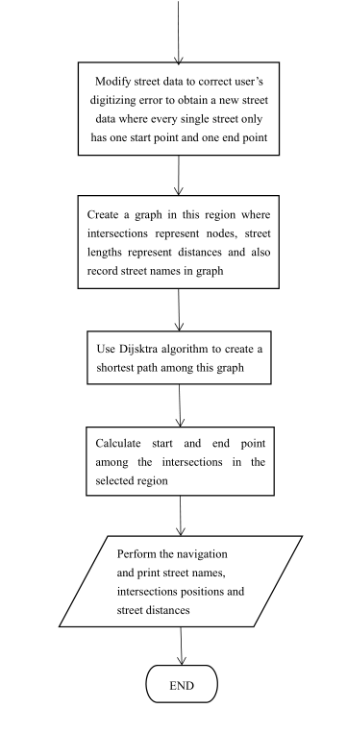
Flowchart of Shortest Route Calculation
8

Slide 11
Listing Created Functions
Name of function | Usage
dis(a,b) | calculate the distance between two points a & b
getposition_citizen(id_num) | get XY coordinate according to input address ID
destination_info(type) | return destination shape file and attribute name according to input type
location_distance_calc(c_x,c_y,fc,a_name) | get the shortest place XY coordinate and distance
store_street_intersections() | store all intersections into a list
get_max_and_min(x,y,park_x,park_y) | get the region four vertexs
get_region(start_x,end_x,start_y,end_y,storedata) | get the region of intersections
get_street(start_x,end_x,start_y,end_y,storedata) | get the region of streets
create_gragh(region,region_num,street) | greate the graph in the region
dijsktra(graph, initial, end) | perform dijsktra algorithm to output the shortest route
shortest(region,x,y,l_x,l_y) | assign start and end point
navigation(path,region,street,type,l_name) | print navigation information
9

Slide 12
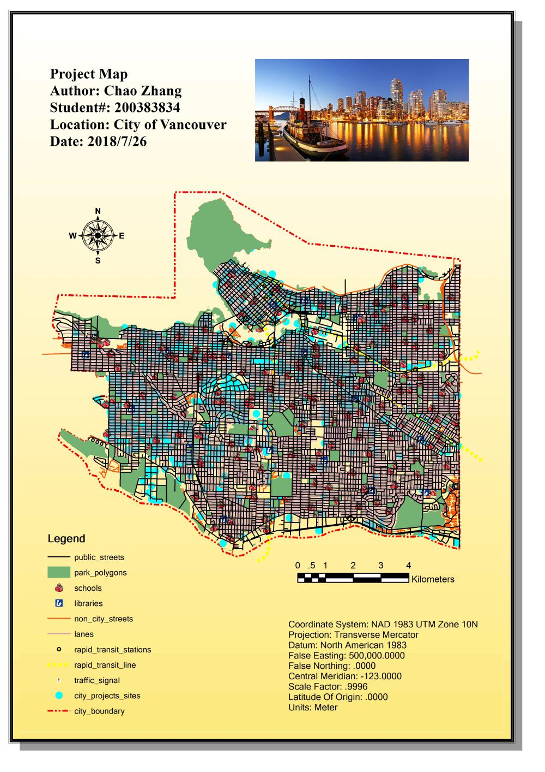
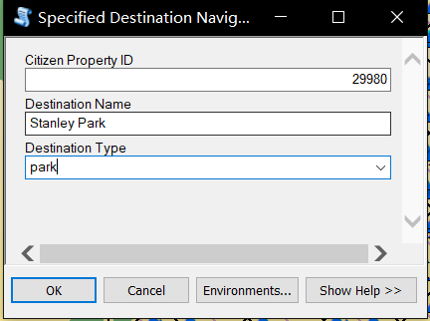
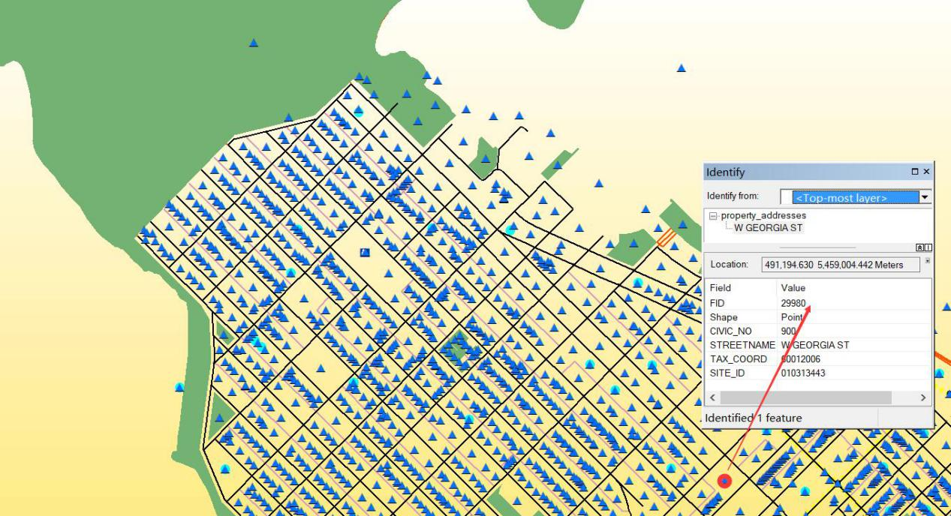
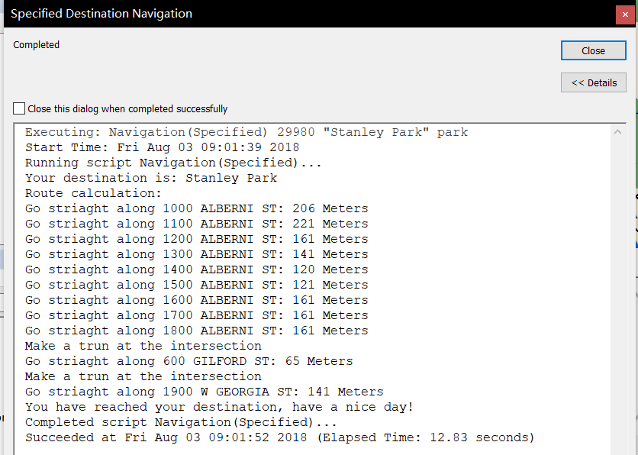
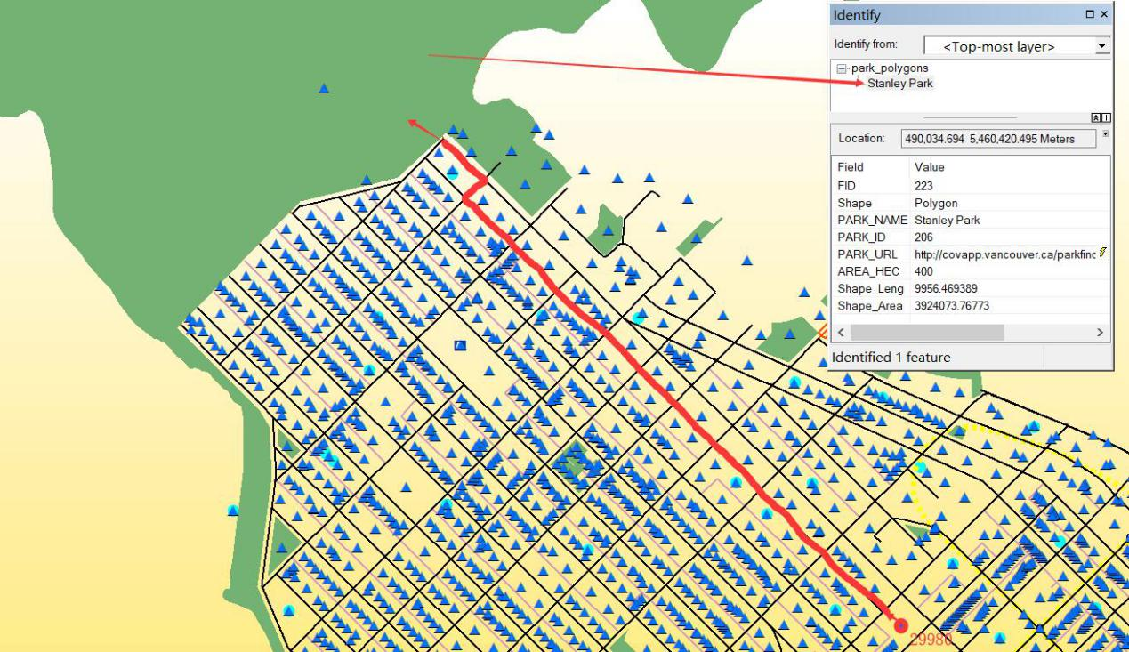
Results and Discussion
10

Slide 13
Conclusion and future work
This toolbox is created to handle all navigation among Vancouver so it may take a long time for large areas route calculation. Due to the core mind is to make a graph among street intersections, once the covered area is bigger, it needs more time to deal with the created graph.
Future work:
Find other data and add them into the map;
Improve the city network graph modeling;
Speed up Dijstra's algorithm for shortest route calculation.
11

Slide 14
THANKS FOR YOUR ATTENTION

